Slide 1
Feedback from WP2 discussions
WP2

Slide 2
Briefing
Communication-We have improved communication but there is need for wider participation
Priorities for WP2
Develop rapid screening tools for banana pest & diseases (Sigatoka, Weevil,FOC,nemtodes)
Reviewed progress
Harmonization germplasm
Inventory of ongoing trial related to WP2
Musabase training –inconsistencies need to be addressed

Slide 3
Briefing
Classification of germplasm response to target pest (R vs S; R, MR, S; R; MR, MS,R)
Input from breeders required on preferred classification
Screening of parental materialS
Pest and pathogen collections

Slide 4
Way forward
Use of same varieties in development of protocols
Use known resistant and susceptible for protocol development
Validation to be used on a common set of germplasm for all the four pests
WP2 leader compiling a common list
19 cultivars from ITC

Slide 5
What is rapid
Weevil –minimum of 10 months?
Sigatoka -3 months?
Nematodes -4months?
Fusarium wilt -3 months?

Slide 6
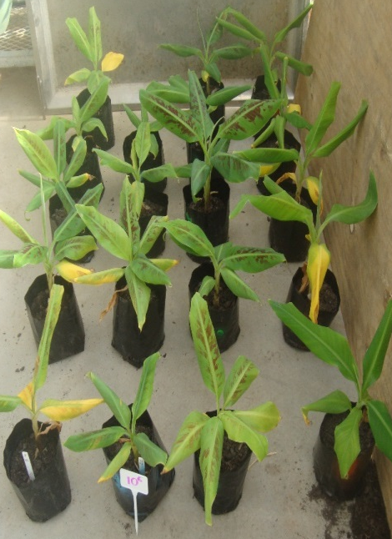
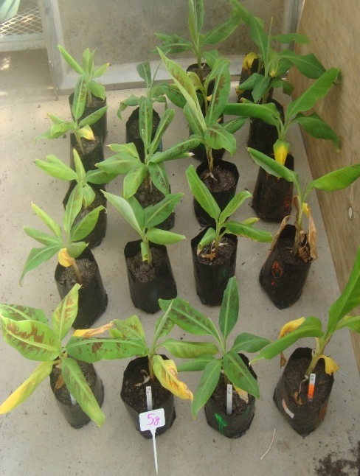
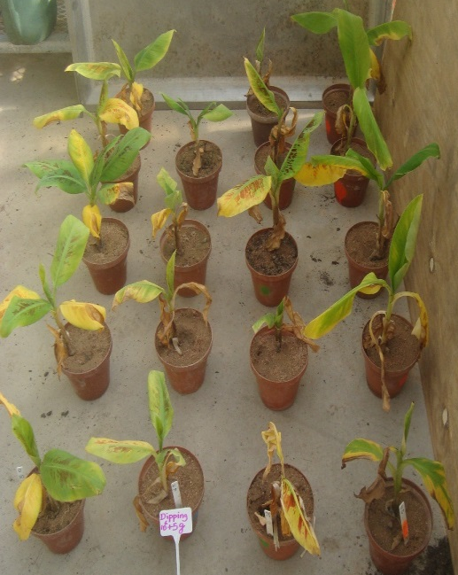
Preliminary trial
Dipping in spores suspension (10⁶ spores/ml) + replanting in sand amended with 5g of Foc inoculated millet seeds
Soil drenching with 10⁶ spores/ml (20ml used)
Sand amended with 5g/kg of millet seeds inoculated with Foc
W D C G
W D C G
W D C G
W=Williams; D=DPM; C=Cavendish Aska; G=GCTCV119

Slide 7
Next?
Evaluate the age of plantlets (In vitro, 1- 2-3Month old plantlets)
Evaluate the value of biochemicals as rapid screening method)-Phenolics and enzymes
Validate the technique on 19 cultivars representing different groups of bananas

Slide 8
Life cycle of banana weevil
Changes in larva weights when red headed eggs are transferred on Corms or flower stalks
Adult (up to 4 years)
K-selected (long lived, few eggs)
Moisture loving
Limited dispersal
Egg (1 week)
Larva (4-5 weeks)
Pupa (1 week)
Loss of biochemical defense mechanism from the detached materials
Antibiosis/antixenosis
Stress of changing detached corm pieces

Slide 9
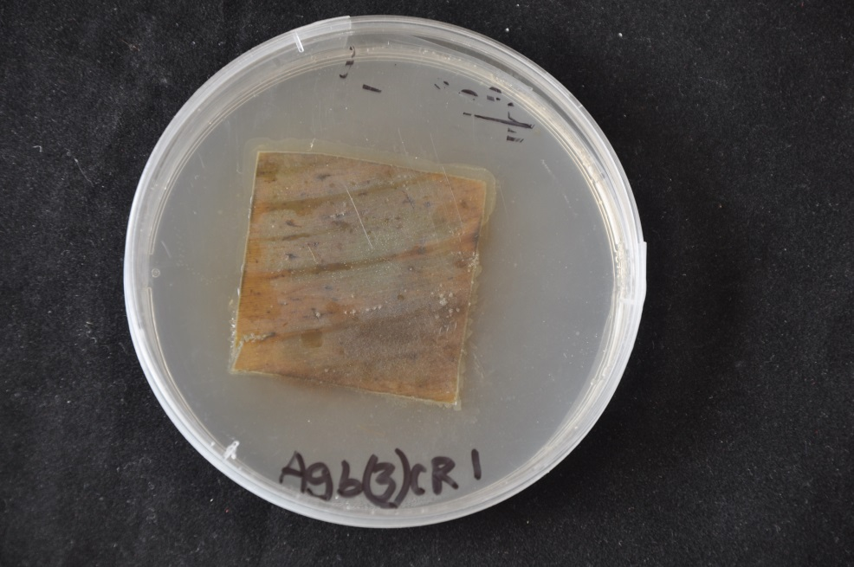
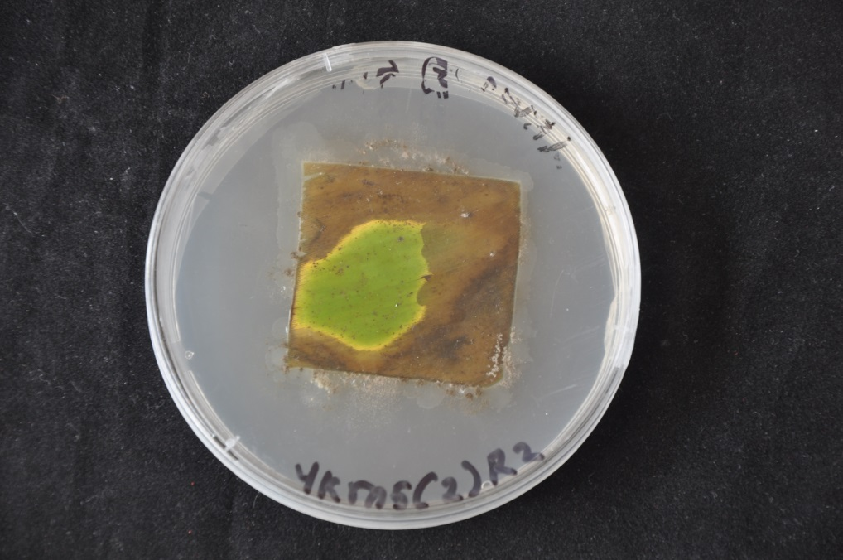
Sigatoka
Detached leaf assays
Developed and optimised
Pending validation
Susceptible
Resistant

Slide 10
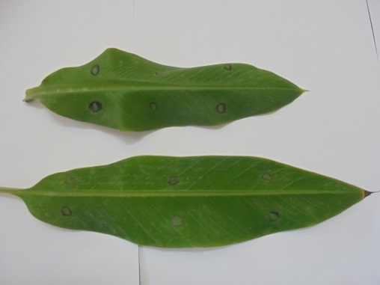
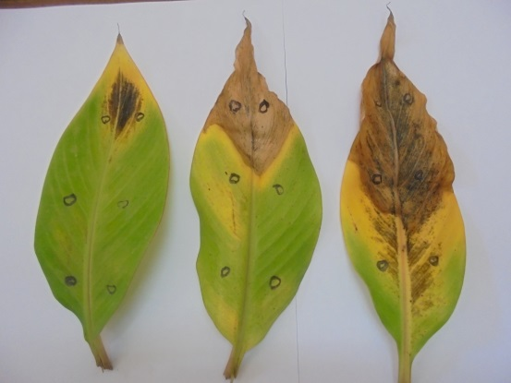
Screen house Sucker derived plant
Inoculum application
Resistant 45 days after inoculation
Susceptible

Slide 11
What can we deliver now
Characterized collections of pests and pathogens
Small plant screening assays
Fusarium
Sigatoka
Corm screening for weevils
Single root assays for nematodes
Preliminary data on Mchare, Narita and banana collection
Sigatoka
Weevils

Slide 12
Questions??

